Slide 1
Running python on
Hardware with
Circuitpython
Tammy Cravit
itsme@tammymakesthings.com github.com/TammyMakesThings
twitch.tv/TammyMakesThings

Slide 2

What are microcontrollers?
Wikipedia says:
”A microcontroller is a small computer on a single…integrated circuit. Microcontrollers ate designed for embedded applications, in contrast to the microprocessors used in personal computers consisting of various…chips.”
Microcontrollers typically include a variety of digital and analog I/O pins for interfacing with external hardware.

Slide 3
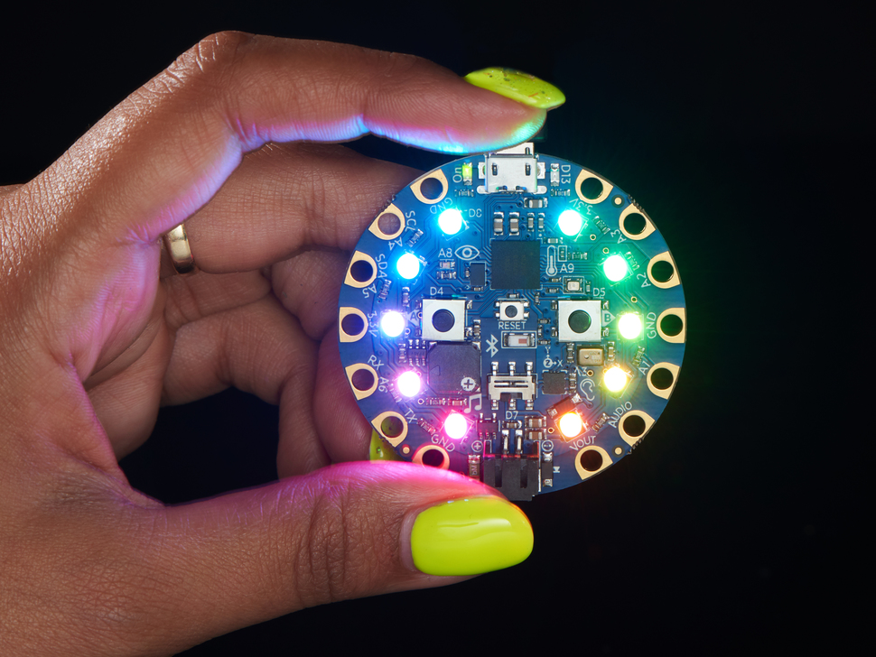
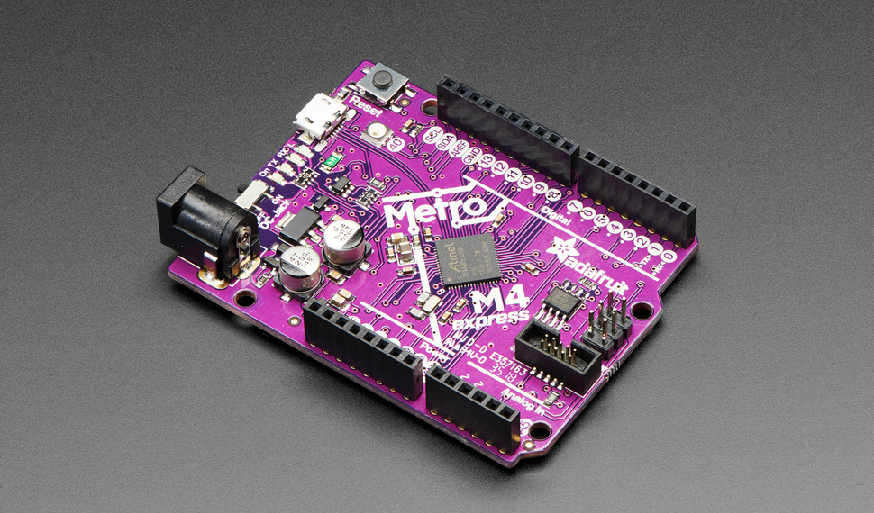
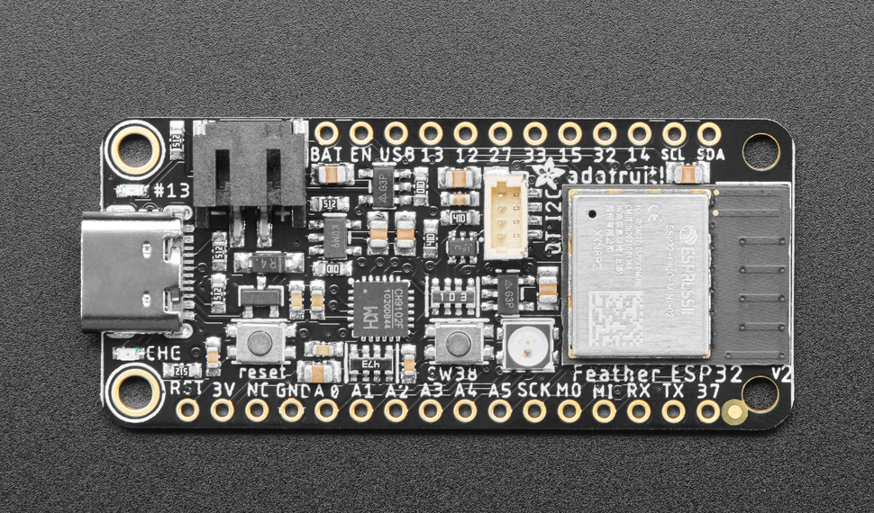

Slide 4




What is circuitpython?
A version of Python that runs on more than 300 microcontroller boards
CircuitPython also runs on Raspberry Pi and other single-board computers (SBC)
CircuitPython is a fork of the MicroPython project
Sponsored by Adafruit, an NYC-based open source hardware manufacturer

Slide 5
Why CircuitPython?
Microcontrollers were traditionally programmed in C or C++
Changing your code typically required recompiling and then re-flashing the microcontroller
Interfacing with hardware traditionally required direct manipulation of the hardware’s I/O signals
All of these things added up to significant barriers to entry and use for non-expert users of this hardware.

Slide 6
How does it work?
Plug a CircuitPython microcontroller into your computer’s USB port. It appears on your computer as a USB drive.
Download your code (and hardware support libraries) to the drive. CircuitPython automatically starts running your code.
Connect to the USB serial port to see debugging output and access a Python REPL.
When you change your code, the device automatically restarts.
It’s that easy!

Slide 7
Development tools
You can use any Python development tools you want:
Visual Studio Code
PyCharm
TextMate/Sublime Text/etc.
The easiest way to install libraries is with circup (pip install circup)
The mu editor (codewith.mu) is handy for beginners and also provides an integrated connection to the serial port and REPL.

Slide 8
So what can we do with this?
CircuitPython projects can interact with:
Sensors
Lights
Motors
WiFi / Bluetooth / LoRA
And much more!
Some CircuitPython devices can behave like USB HID devices - so you can build your own smart keyboard.
The limit is really your imagination!

Slide 9
Demo 1
The obligatory blinking light

Slide 10
The blinking neopixel
import time
import board
import neopixel
pixel = neopixel.NeoPixel(board.NEOPIXEL, 1)
while True:
pixel.fill((140, 25, 255))
time.sleep(1.0)
pixel.fill((0, 0, 0))
time.sleep(1.0)

Slide 11
Demo 2
Fun with NeoPixels

Slide 12
Rainbow neopixels
import time
import board
from rainbowio import colorwheel
import neopixel
pixels = neopixel.NeoPixel(board.NEOPIXEL, 1, auto_write=False)
while True:
for i in range(255):
pixels.fill(colorwheel(i % 255))
pixels.show()
time.sleep(0.1)

Slide 13
That’s cool - what else can it do?
Let’s try some code that talks to the environment.
BMP-280 temperature/barometric pressure sensor
We’ll connect these to our microcontroller with STEMMA QT, standard connectors for I2C sensors which makes the hardware super easy.
If your microcontroller or sensor don’t have STEMMA QT ports, you can connect them directly. (See the documentation for which pins to use.)

Slide 14
Demo 3
Let’s interact with the environment

Slide 15
Reading the sensor values
import board
import adafruit_bmp280
i2c = board.I2C()
sensor = adafruit_bmp280.Adafruit_BMP280_I2C(i2c)
# Calibrate the sensor
sensor.sea_level_pressure = 1011.85
while True:
print(f"Temperature: {((sensor.temperature*1.8)+32):.2f} F")
print(f"Pressure : {(sensor.pressure / 33.86):.2f} in Hg")
print(f"Altitude : {(sensor.altitude * 3.3):.1f} ft MSL\n")
time.sleep(5)

Slide 16
Demo 4
DisplayIO and Drawing on LED displays

Slide 17
Simple display EXAMPLE in displayio
import time
from random import randint
import board
import terminalio
from adafruit_display_text import label
display = board.DISPLAY
text = "HELLO WORLD"
font = terminalio.FONT
color = 0x0000FF
text_area = label.Label(font, text=text, color=color)
text_area.x = 100
text_area.y = 80
display.show(text_area)
while True:
time.sleep(0.5)
text_area.x = random.randint(1, 120)
text_area.y = random.randint(1, 120)

Slide 18
Getting involved
Buy a CircuitPython device and try it out!
www.adafruit.com
www.circuitpython.org
Use the discount code DESERTPY on Adafruit to save on your hardware!
Join the Adafruit Discord (adafru.it/discord) in the #help-with-circuitpython and #circuitpython-dev channels
Check out hundreds of project guides at learn.adafruit.com

Slide 19
Questions?
itsme@tammymakesthings.com
twitch.tv/tammymakesthings github.com/tammymakesthings

